Slide 1

CIS 467 :Data Mining
Department of Information Systems
Faculty of Information Technology and Computer Sciences
Yarmouk University – Jordan
Notes:
1

Slide 2
Outline
What Is Classification?
Issues Regarding Classification
Steps of Data Classification
Accuracy and Error Measures
Classification by Decision Tree Induction
Bayesian Classification
Lazy Classifiers (kNN)
Methods for Evaluating the Accuracy of a Classifier
Holdout method, K-Fold Cross Validation, and Confusion Matrix
Rule-Based Classification
Rule Extraction from a Decision Tree
Zero Rule Classifier
One Rule classifier
Using the data mining tool for data Classification

Slide 3
Topic 4
Classification
Main Source: J. Han Book
Data Mining: Concepts and Techniques (3nd ed.)
(Chapter 8)

Slide 4
Introduction
Databases are rich with hidden information that can be used for intelligent decision making.
Classification and prediction are two forms of data analysis that can be used to extract models describing important data classes or to predict future data trends. Such analysis can help provide us with a better understanding of the data at large.
For example, we can build a classification model to categorize bank loan applications as either safe or risky, or a prediction model to predict the expenditures in dollars of potential customers on computer equipment given their income and occupation.
In this chapter, you will learn basic techniques for data classification, such as how to build decision tree classifiers, Bayesian classifiers, k-nearest-neighbor classifiers, and rule based classifiers.

Slide 5
Classification vs. Prediction
Classification
Predicts categorical class labels (discrete or nominal)
Classifies data (constructs a model) based on the training set and the values (class labels) in a classifying attribute and uses it in classifying new data.
Prediction
Models continuous-valued functions, i.e., predicts unknown or missing values
Typical applications
Credit approval
Target marketing
Medical diagnosis
Fraud detection

Slide 6
Examples for Classification Problems?
Example 1: A bank loans officer needs analysis of her data to learn which loan applicants are “safe” and which are “risky” for the bank.
Example 2: A marketing manager at AllElectronics needs data analysis to help guess whether a customer with a given profile will buy a new computer.
Example 3 : A medical researcher wants to analyze breast cancer data to predict which one of three specific treatments a patient should receive.
In each of these examples, the data analysis task is classification, where a model or classifier is constructed to predict class (categorical) labels, such as “safe” or “risky” for the loan application data; “yes” or “no” for the marketing data; or “treatment A,” “treatment B,” or “treatment C” for the medical data.

Slide 7
Supervised vs. Unsupervised Learning
Supervised learning (classification)
Supervision: The training data (observations, measurements, etc.) are accompanied by labels indicating the class of the observations
New data is classified based on the training set
Unsupervised learning (clustering)
The class labels of training data is unknown
Given a set of measurements, observations, etc. with the aim of establishing the existence of classes or clusters in the data

Slide 8
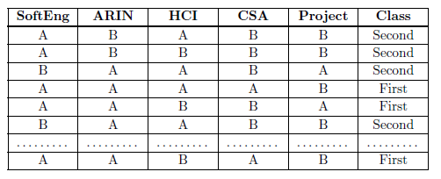
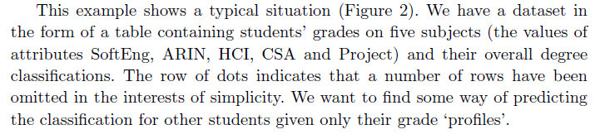
Dataset Example

Slide 9
Classification — A Two-Step Process
“How does classification work?” Data classification is a two-step process, consisting of a learning step (where a classification model is constructed) and a classification step (where the model is used to predict class labels for given data).
1) Learning Step (Model construction):
In this step a classifier is built describing a predetermined set of data classes or concepts, where a classification algorithm builds the classifier by analyzing or “learning from” a training set made up of database tuples and their associated class labels.
The model is represented as classification rules, decision trees, or mathematical formulae
2) Model usage: for classifying future or unknown objects
A) Model Evaluation: Estimate accuracy of the model
The known label of test sample is compared with the classified result from the model
Accuracy rate is the percentage of test set samples that are correctly classified by the model
Test set is independent of training set, otherwise over-fitting will occur
B) Use the Model: If the accuracy is acceptable, use the model to classify data tuples whose class labels are not known

Slide 10
Illustrative Example (1) Step (1): Model Construction
Classification
Algorithms
Training
Data
Classifier
(Model)
IF rank = ‘professor’
OR years > 6
THEN tenured = ‘yes’

Slide 11
Step (2): Using the Model in Prediction
A
B
Classifier
Testing
Data
Unseen Data
(Jeff, Professor, 4)
Tenured?

Slide 12
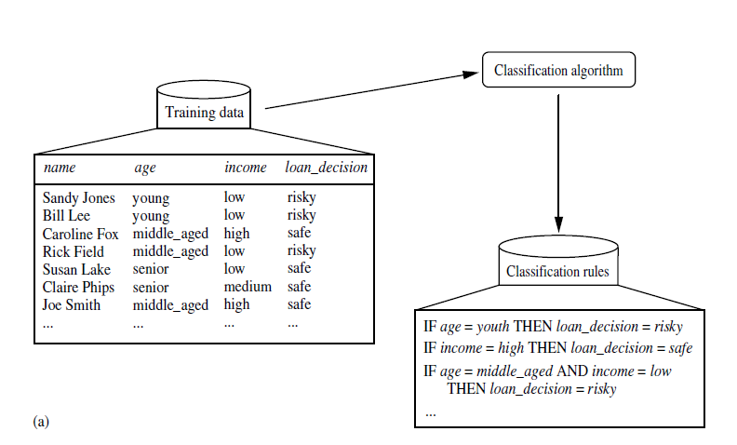
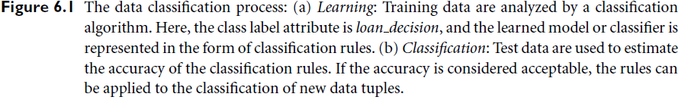
Illustrative Example (2)
Step 1

Slide 13
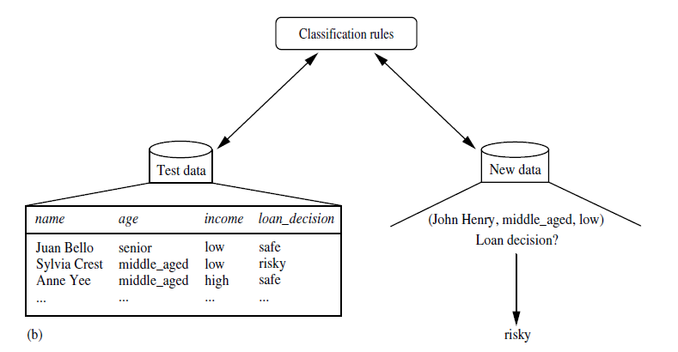
Illustrative Example (2)
Step 2
A
B

Slide 14
Issues Regarding Classification
Reminder: You may need to do Data Preparation
Data cleaning
Preprocess data in order to reduce noise and handle missing values
Relevance analysis (feature selection)
Remove the irrelevant or redundant attributes
Data transformation
Generalize and/or normalize data
…..
Note: details have been covered in Topic 2 (Data Preprocessing)

Slide 15
Classification Techniques to be covered
Decision Tree based Methods
Rule-based Classifiers
Naïve Bayes Classifier
Lazy Learning (KNN Classifier)
ZeroR Classifier
OneR Classifier
---------------------------------------------------------------
Memory based reasoning
Neural Networks
Bayesian Belief Networks
Support Vector Machines
Etc……
Yes in CIS 467
No

Slide 16
Comparing Classification and Prediction Methods
Classification and prediction methods can be compared and evaluated according to the following criteria:
Accuracy : The accuracy of a classifier refers to the ability of a given classifier to correctly predict the class label of new or previously unseen data (i.e., tuples without class label information)
Speed : This refers to the computational costs involved in generating and using the given classifier or predictor (i.e time to construct the model (training time) and time to use the model (classification/prediction time)
Robustness: This is the ability of the classifier or predictor to make correct predictions given noisy data or data with missing values.
Scalability: This refers to the ability to construct the classifier or predictor efficiently given large amounts of data (i.e, efficiency in disk-resident databases )
Interpretability : This refers to the level of understanding and insight that is provided by the classifier or predictor. Interpretability is subjective and therefore more difficult to assess.
Other measures, e.g., goodness of rules, such as decision tree size or compactness of classification rules

Slide 17
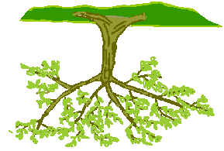
8.2 Classification by Decision Tree Induction

Slide 18
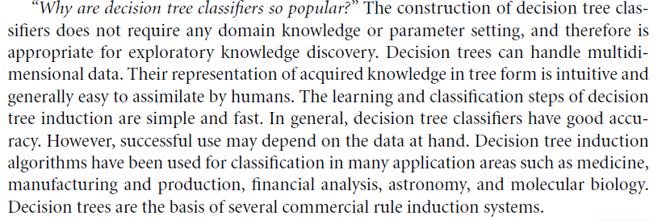
Why decision tree?
Decision trees are powerful and popular tools for classification and prediction.
Decision trees represent rules, which can be understood by humans and used in knowledge system such as database.

Slide 19
Definitions
Decision tree induction is the learning of decision trees from class-labeled training tuples.
A decision tree is a flowchart-like tree structure, where each internal node (non leaf node) denotes a test on an attribute, each branch represents an outcome of the test, and each leaf node (or terminal node) holds a class label. The topmost node in a tree is the root node.
How are decision trees used for classification?:
Given a tuple, X, for which the associated class label is unknown, the attribute values of the tuple are tested against the decision tree. A path is traced from the root to a leaf node, which holds the class prediction for that tuple.
Decision trees can easily be converted to classification rules.

Slide 20
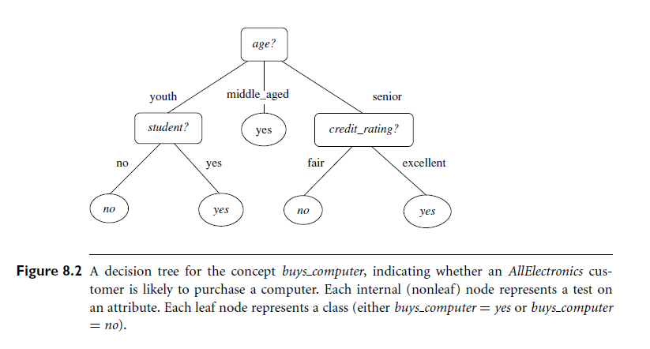
Decision Tree Example 1

Slide 21
Example 2:
Outlook | Temp | Humidity | Windy | Play
Sunny | Hot | High | False | No
Sunny | Hot | High | True | No
Overcast | Hot | High | False | Yes
Rainy | Mild | High | False | Yes
Rainy | Cool | Normal | False | Yes
Rainy | Cool | Normal | True | No
Overcast | Cool | Normal | True | Yes
Sunny | Mild | High | False | No
Sunny | Cool | Normal | False | Yes
Rainy | Mild | Normal | False | Yes
Sunny | Mild | Normal | True | Yes
Overcast | Mild | High | True | Yes
Overcast | Hot | Normal | False | Yes
Rainy | Mild | High | True | No
- A fictitious example which has been used for illustration by many authors, notably Quinlan, is that of a golfer who decides whether or not to play each day on the basis of the weather.
- The Table shows the results of two weeks (14 days) of observations of weather conditions and the decision on whether or not to play.

Slide 22



Decision Tree Example 2
Outlook
sunny
overcast
rain
Humidity
Yes
Windy
high
normal
true
false
No
Yes
No
Yes

Slide 23
key requirements
Attribute-value description: object or case must be expressible in terms of a fixed collection of properties or attributes (e.g., hot, mild, cold).
Predefined classes (target values): the target function has discrete output values (bollean or multiclass)
Sufficient data: enough training cases should be provided to learn the model.

Slide 24
Principled Criterion
Selection of an attribute to test at each node - choosing the most useful attribute for classifying examples.
Information Gain
Measures how well a given attribute separates the training examples according to their target classification.
This measure is used to select among the candidate attributes at each step while growing the tree

Slide 25
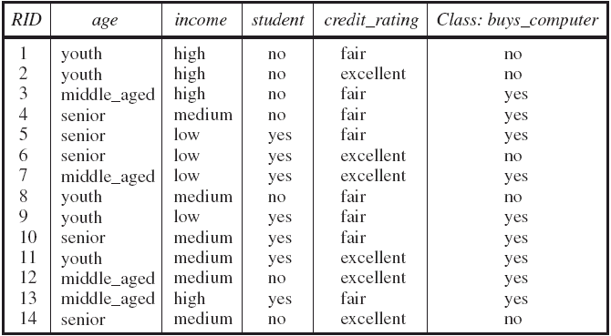
The Buys Computer Dataset (From Book)
Input: Training Dataset
Play around this example: see next slide

Slide 26
Some Preliminary Questions:
How many instances are there?
How many classes are there?
How many values for each attribute?
What is the percentage of each class?
How many students are there?
How many students who bought computers?
How many youth students are there?
How many youth students bought computers?
…….

Slide 27
Decision Tree Induction
During the late 1970s and early 1980s, J. Ross Quinlan, a researcher in machine learning, developed a decision tree algorithm known as ID3.
This work expanded on earlier work on concept learning systems, described by E. B. Hunt, J. Marin, and P. T. Stone.
Quinlan later presented C4.5 (a successor of ID3), which became a benchmark to which newer supervised learning algorithms are often compared.
The new version is called C5.0 (or See5.0).

Slide 28
Algorithm for Decision Tree Induction: Basic Infromation
Basic algorithm (a greedy algorithm)
Tree is constructed in a top-down recursive divide-and-conquer manner
At start, all the training examples are at the root
Attributes are categorical (if continuous-valued, they are discretized in advance)
Examples are partitioned recursively based on selected attributes
Test attributes are selected on the basis of a heuristic or statistical measure (e.g., information gain)
Conditions for stopping partitioning
All samples for a given node belong to the same class
There are no remaining attributes for further partitioning – majority voting is employed for classifying the leaf
There are no samples left

Slide 29
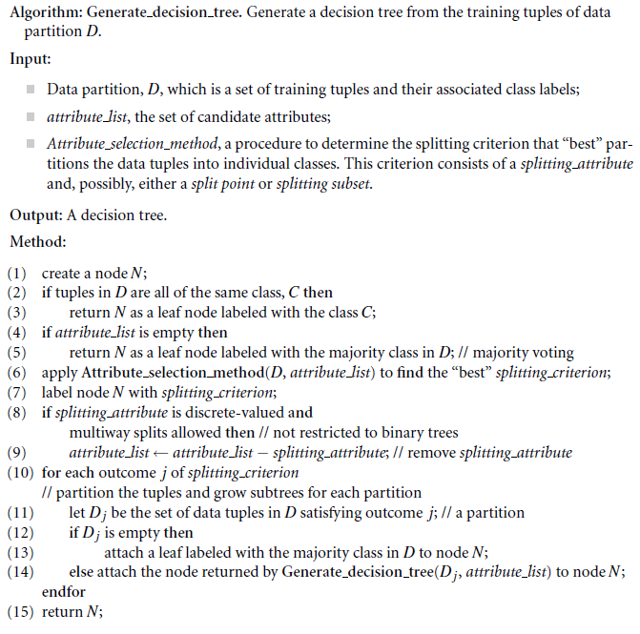
Basic algorithm for inducing a decision tree from training tuples

Slide 30
Attribute Selection Measure:
1) Information Gain (ID3/C4.5)
Select the attribute with the highest information gain
Let p_{i} be the probability that an arbitrary tuple in D belongs to class C_{i}, estimated by |C_{i, D}|/|D|
Expected information (entropy) needed to classify a tuple in D:
Information needed (after using A to split D into v partitions) to classify D:
Information gained by branching on attribute A
Notes:
I : the expected information needed to classify a given sample
E (entropy) : expected information based on the partitioning into subsets by A

Slide 31
The Buys Computer Dataset (AllElectronics)
Reminder: This is the Input Training Dataset

Slide 32

Example : Induction of a decision tree using information gain
Table 6.1 presents a training set, D, of class-labeled tuples randomly selected from the AllElectronics customer database.
In this example, each attribute is discrete-valued.
The class label attribute, buys computer, has two distinct values (namely, {yes, no}); therefore, there are two distinct classes (that is, m = 2).
Let class C1 correspond to yes and class C2 correspond to no.
There are nine tuples of class yes and five tuples of class no.
A (root) node N is created for the tuples in D. To find the splitting criterion for these tuples, we must compute the information gain of each attribute.
We first use Equation (6.1) to compute the expected information needed to classify a tuple in D:
Next, we need to compute the expected information requirement for each attribute.

Slide 33
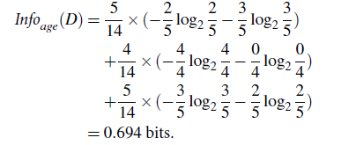
Example : Induction of a decision tree using information gain (Continue)
Let’s start with the attribute age. We need to look at the distribution of yes and no tuples for each category of age.
For the age category youth, there are two yes tuples and three no tuples.
For the category middle aged, there are four yes tuples and zero no tuples.
For the category senior, there are three yes tuples and two no tuples.
Using Equation (6.2), the expected information needed to classify a tuple in D if the tuples are partitioned according to age is :
Hence, the gain in information from such a partitioning would be:

Slide 34
Example : Induction of a decision tree using information gain (Continue)
Similarly, we can compute
Gain (income) = 0.029 bits,
Gain (student) = 0.151 bits, and
Gain (credit rating) = 0.048 bits.
Because age has the highest information gain among the attributes, it is selected as the splitting attribute.
Node N is labeled with age, and branches are grown for each of the attribute’s values.
The tuples are then partitioned accordingly, as shown in next Figure. Notice that the tuples falling into the partition for age = middle aged all belong to the same class. Because they all belong to class “yes,” a leaf should therefore be created at the end of this branch and labeled with “yes.”
The final decision tree returned by the algorithm is shown in Figure 8.2.

Slide 35
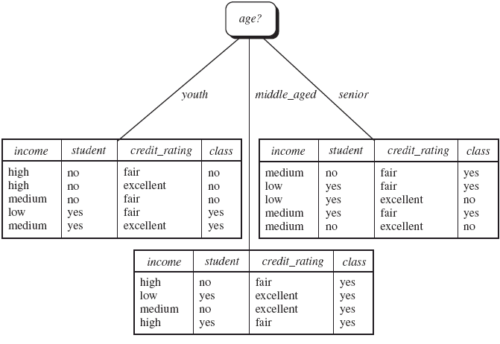
The decision tree produced from Step 1
Stop

Slide 36
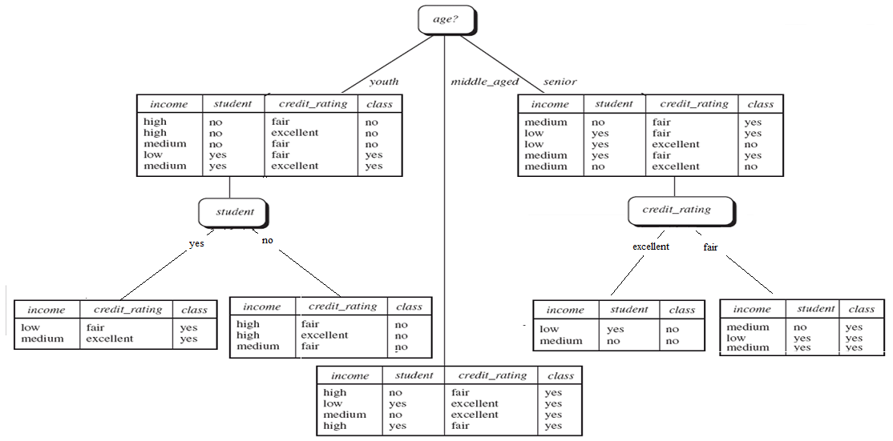
The decision tree produced from Step 2

Slide 37
Output: A Decision Tree for “buys_computer”

Slide 38
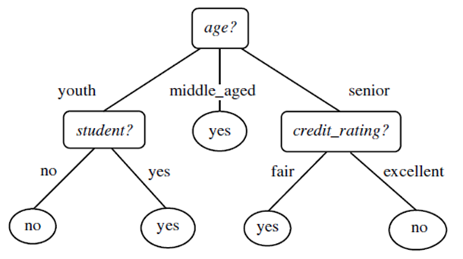
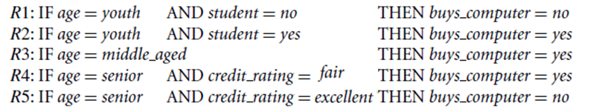
Rule Extraction from a Decision Tree
Rules are easier to understand than large trees
One rule is created for each path from the
root to a leaf.
Each attribute-value pair along a path forms a conjunction: the leaf holds the class prediction
Rules are mutually exclusive and exhaustive
Example: Rule extraction from our buys_computer decision-tree

Slide 39
Step 2: Model Evaluation
In Class Exercise:
Given the following Test Dataset, find the classification Accuracy for the Model.
This is the actual class label
No | Age | Income | Student | Credit Rating | Buys computer
1 | Youth | High | No | Fair | No
2 | Senior | Low | Yes | Excellent | Yes
3 | Middle-Age | High | No | Fair | Yes
4 | Youth | Medium | No | Excellent | No
5 | Senior | Low | Yes | Fair | Yes
Classifier Output
No | ✓
No | X
Yes | ✓
No | ✓
Yes | ✓
Estimated Accuracy = 4/5
= 80%

Slide 40
Putting the Classifier output in the Confusion Matrix
A confusion matrix contains information about actual and predicted
classifications done by a classification system.
 |  | Predicted Class
 | classes | buy_computer = yes | buy_computer = no | Accuracy (%)
Actual Classes | buy_computer = Yes | 2 | 1 | 67.0
 | buy_computer = No | 0 | 2 | 100
 | Accuracy | 100 | 67.0 | 80.0

Slide 41
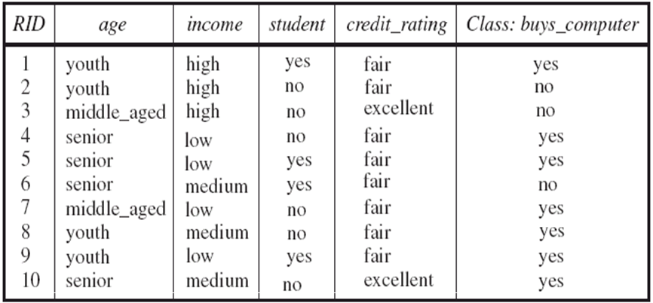
Exercise / Home Work
Q) Given the following Test Dataset and the previous Decision Tree,
1) Build The Confusion Matrix.
2) Find the classification Accuracy for the Model.

Slide 42
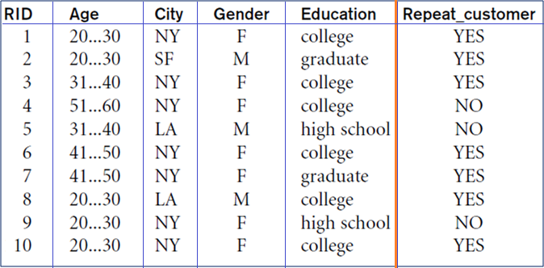
Exercise / Home Work
Q) Given the following Dataset:
1) Build The Decision Tree.
2) Use the same Dataset to build the confusion matrix and find the classification Accuracy for the Model.

Slide 43
Attribute Selection Measure: 2) Gain Ratio for Attribute Selection (C4.5)
Information gain measure is biased towards attributes with a large number of values
C4.5 (a successor of ID3) uses gain ratio to overcome the problem (normalization to information gain)
GainRatio(A) = Gain(A)/SplitInfo(A)
Ex.
gain_ratio(income) = 0.029/0.926 = 0.031
The attribute with the maximum gain ratio is selected as the splitting attribute
Note: To be presented by one of the good students with full example.

Slide 44
The Weaknesses of Decision Tree Methods
Decision trees are less appropriate for estimation tasks where the goal is to predict the value of a continuous variable such as income, blood pressure, or interest rate.
Most decision tree algorithms examine a single field at a time.
Decision trees are prone to errors in classification problems with many classes and relatively small number of training examples.
Decision trees are computationally expensive to train.
Notes:
The weaknesses of decision tree methods
Decision trees are less appropriate for estimation tasks where the goal is to predict the value of a continuous attribute.
Decision trees are prone to errors in classification problems with many classes and relatively small number of training examples.
Decision tree can be computationally expensive to train. The process of growing a decision tree is computationally expensive. At each node, each candidate splitting field must be sorted before its best split can be found. In some algorithms, combinations of fields are used and a search must be made for optimal combining weights. Pruning algorithms can also be expensive since many candidate sub-trees must be formed and compared.
Decision trees do not treat well non-rectangular regions. Most decision-tree algorithms only examine a single field at a time. This leads to rectangular classification boxes that may not correspond well with the actual distribution of records in the decision space.

Slide 45
Tree Pruning and Overfitting
When a decision tree is built, many of the branches will reflect anomalies in the training data due to noise or outliers. Tree pruning methods address this problem of overfitting the data.
Overfitting: An induced tree may overfit the training data
Too many branches, some may reflect anomalies due to noise or outliers
Poor accuracy for unseen samples
Two approaches to avoid overfitting
Prepruning: Halt tree construction early—do not split a node if this would result in the goodness measure falling below a threshold
Difficult to choose an appropriate threshold
Postpruning: Remove branches from a “fully grown” tree—get a sequence of progressively pruned trees
Use a set of data different from the training data to decide which is the “best pruned tree”
Note: To be presented by one of the good students with full example.

Slide 46
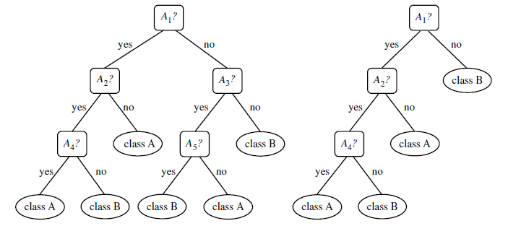
Example

Slide 47
The Implementation of Decision Tree Algorithm
There are several implementations for the decision tree algorithm.
The first version is called ID3
The second version is called C4.5.
J48 is an open source Java implementation of the C4.5 algorithm in the weka data mining tool.
The new version is called C5.0 (See5.0)

Slide 48
The ID3 Pseudocode
id3(examples, attributes)
'''
examples are the training examples. attributes is a list of
attributes that may be tested by the learned decison tree. Returns
a tree that correctly classifies the given examples. Assume that
the targetAttribute, which is the attribute whose value is to be
predicted by the tree, is a class variable.
'''
node = DecisionTreeNode(examples)
# handle target attributes with arbitrary labels
dictionary = summarizeExamples(examples, targetAttribute)
for key in dictionary:
if dictionary[key] == total number of examples
node.label = key
return node
# test for number of examples to avoid overfitting
if attributes is empty or number of examples < minimum allowed per branch:
node.label = most common value in examples
return node
bestA = the attribute with the most information gain
node.decision = bestA
for each possible value v of bestA:
subset = the subset of examples that have value v for bestA
if subset is not empty:
node.addBranch(id3(subset, targetAttribute, attributes-bestA))
return node

Slide 49
Information Gain Pseudocode
infoGain(examples, attribute, entropyOfSet)
gain = entropyOfSet
for value in attributeValues(examples, attribute):
sub = subset(examples, attribute, value)
gain -= (number in sub)/(total number of examples) * entropy(sub)
return gain

Slide 50
Entropy Pseudocode
entropy(examples)
'''
log2(x) = log(x)/log(2)
'''
result = 0
# handle target attributes with arbitrary labels
dictionary = summarizeExamples(examples, targetAttribute)
for key in dictionary:
proportion = dictionary[key]/total number of examples
result -= proportion * log2(proportion)
return result

Slide 51
For More Examples in the Net You can Visit:
http://www.codeproject.com/Articles/259241/ID3-Decision-Tree-Algorithm-Part-1
http://webdocs.cs.ualberta.ca/~aixplore/learning/DecisionTrees/InterArticle/1-DecisionTree.html
http://en.wikipedia.org/wiki/C4.5_algorithm#Pseudocode
http://en.wikipedia.org/wiki/Decision_tree
http://www.hiraeth.com/books/ai96/QBB/id3.html
http://web.arch.usyd.edu.au/~wpeng/DecisionTree2.pdf
http://www.cse.unsw.edu.au/~billw/cs9414/notes/ml/06prop/id3/id3.html
…
And More ……….

Slide 52
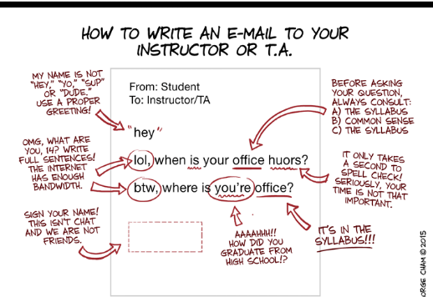
Break

Slide 53

In Class Practical Session for Data Classification Using Decision Tree

Slide 54
6. 4 Bayesian Classification (Naïve Bays Classifier)

Slide 55
Bayesian classifiers: Basic Information
Bayesian classifiers are statistical classifiers. They can predict class membership probabilities, such as the probability that a given tuple belongs to a particular class.
Bayesian classifier known as the naïve Bayesian classifier to be comparable in performance with decision tree and selected neural network classifiers.
Bayesian classifiers have also exhibited high accuracy and speed when applied to large databases.
Naïve Bayesian classifiers assume that the effect of an attribute value on a given class is independent of the values of the other attributes. This assumption is called class conditional independence.

Slide 56
Bayesian Theorem: Basics
Bayes’ theorem is named after Thomas Bayes.
Let X be a data sample (“evidence”): class label is unknown
Let H be a hypothesis that X belongs to class C
Classification is to determine P(H|X), the probability that the hypothesis holds given the observed data sample X
P(H) (prior probability), the initial probability
E.g., X will buy computer, regardless of age, income, …
P(X): probability that sample data is observed
P(X|H) (posteriori probability), the probability of observing the sample X, given that the hypothesis holds
E.g., Given that X will buy computer, the prob. that X is 31..40, medium income

Slide 57
Bayesian Theorem: Basics
Given training data X, posteriori probability of a hypothesis H, P(H|X), follows the Bayes theorem
Informally, this can be written as
posteriori = likelihood x prior/evidence
Predicts X belongs to C₂ iff the probability P(C_{i}|X) is the highest among all the P(C_{k}|X) for all the k classes
Practical difficulty: require initial knowledge of many probabilities, significant computational cost

Slide 58
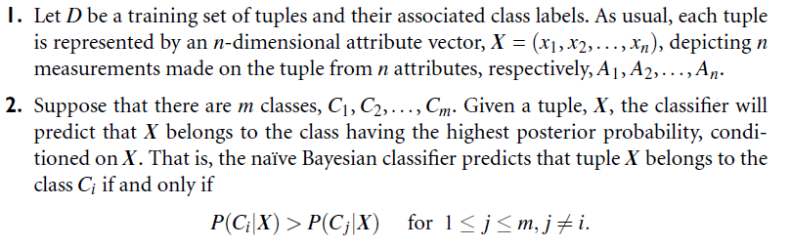
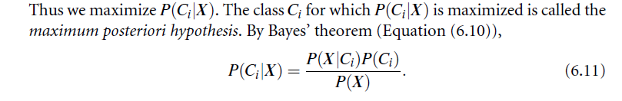
Naïve Bayesian Classification

Slide 59
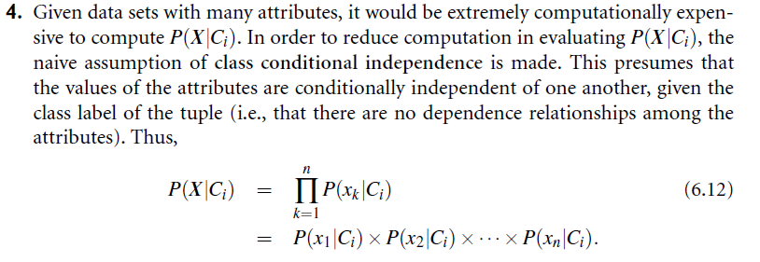
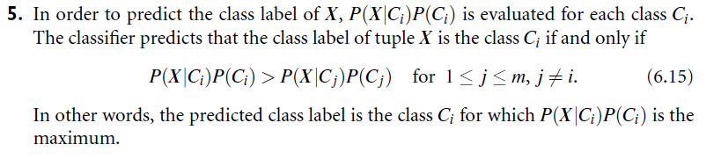
Naïve Bayesian Classification

Slide 60
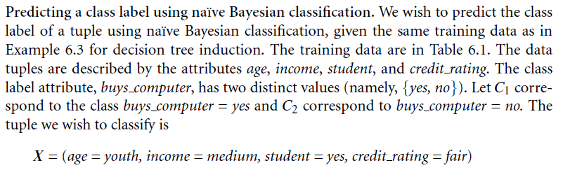
Example

Slide 61
Naïve Bayesian Classifier: Training Dataset
Class: C1:buys_computer = ‘yes’ and C2:buys_computer = ‘no’

Slide 62
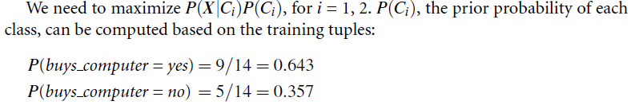
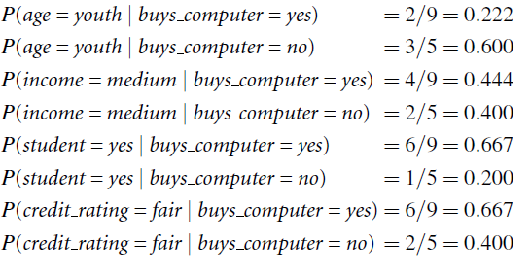
Naïve Bayesian Classifier: Solution
Step 1:
Step 2 : Compute P(X|C_{i}) for each class:

Slide 63
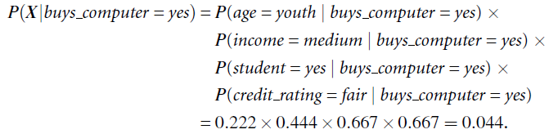

Naïve Bayesian Classifier: Solution
Step 3: Using probabilities in step 2 we obtain:
Step 4: To find the class, Ci, that maximizes P(XjCi) P(Ci), we compute:
Therefore, the naïve Bayesian classifier predicts buys computer = yes for tuple X
Greater

Slide 64
Avoiding the 0-Probability Problem
This problem about if one of the probability of one feature = 0
EX : P( student =yes / Buy_computer = no ) = 0
what we do ??????
We use ( Laplacian correction Method ) to avoid this problem
By adding one to each count that we need
EX: Suppose that for class buy_computer =yes in some training data set containing 1000 tuples .
we have 0 tuple with income = low
have 990 tuple with income = medium
have 10 tuple with income = high
Without Laplacian correction the probability for these tuple
income( low )=0 , income( medium )=990/1000=.99 , income ( high )=10/1000=.01
But when using Laplacian correction
income( low )=1/1003 , income( medium )=991/1003=.988 ,
and income ( high ) = 11/1003 =.011

Slide 65
In Class Exercise
Q) Given the following Test Dataset, use the Naïve base Classifier to:
1) Build The Confusion Matrix.
2) Find the classification Accuracy for the Model.
This is the actual class label
No | Age | Income | Student | Credit Rating | Buys computer
1 | Youth | High | No | Fair | No
2 | Senior | Low | Yes | Excellent | Yes
3 | Middle-Age | High | No | Fair | Yes
4 | Youth | Medium | No | Excellent | No
5 | Senior | Low | Yes | Fair | Yes
Classifier Output
Estimated Accuracy = ??
= ?? %

Slide 66
Exercise / Home Work
Q) Given the following Test Dataset, use the Naïve base Classifier to:
1) Build The Confusion Matrix.
2) Find the classification Accuracy for the Model.

Slide 67
Naïve Bayesian Classifier: Comments
Advantages
Easy to implement
Good results obtained in most of the cases
Disadvantages
Assumption: class conditional independence, therefore loss of accuracy
Practically, dependencies exist among variables
E.g., hospitals: patients: Profile: age, family history, etc.
Symptoms: fever, cough etc., Disease: lung cancer, diabetes, etc.
Dependencies among these cannot be modeled by Naïve Bayesian Classifier
How to deal with these dependencies?
Bayesian Belief Networks

Slide 68
For More Examples in the Net You can Visit:
https://www.youtube.com/watch?v=IlVINQDk4o8
https://www.youtube.com/watch?v=XcwH9JGfZOU

Slide 69
In Class Practical Session for Data Classification Using Naïve base Classifier

Slide 70
Lazy Learning (or Learning from Your Neighbors)
The K-Nearest Neighbor Classifier
(KNN)

Slide 71
Lazy vs. Eager Learning
Lazy vs. eager learning
Lazy learning (e.g., instance-based learning): Simply stores training data (or only minor processing) and waits until it is given a test tuple (Example: KNN)
Eager learning (the above discussed methods): Given a set of training set, constructs a classification model before receiving new (e.g., test) data to classify (Example : Decision Tree).
In Lazy Learning, Classifying unknown records are relatively expensive. Where we need less time in training but more time in predicting
Accuracy
Lazy method effectively uses a richer hypothesis space since it uses many local linear functions to form its implicit global approximation to the target function
Eager: must commit to a single hypothesis that covers the entire instance space

Slide 72
The k-Nearest Neighbor Classifier
The k-nearest-neighbor method was first described in the early 1950s. The method is labor intensive when given large training sets, and did not gain popularity until the 1960s when increased computing power became available.
It has since been widely used in the area of pattern recognition.

Slide 73
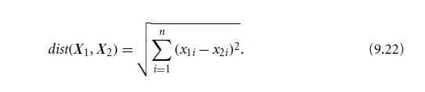
The k-Nearest Neighbor Classifier
- Nearest-neighbor classifiers are based on learning by analogy, that is, by comparing a given test tuple with training tuples that are similar to it.
- The training tuples are described by n attributes. Each tuple represents a point in an n-dimensional space.
- In this way, all of the training tuples are stored in an n-dimensional pattern space.
- When given an unknown tuple, a k-nearest-neighbor classifier searches the pattern space for the k training tuples that are closest to the unknown tuple.
These k training tuples are the k “nearest neighbors” of the unknown tuple.
“Closeness” is defined in terms of a distance metric,
such as Euclidean distance.
_
_
_
.
+
_
+
_
x_{q}
+
_
+

Slide 74
Nearest Neighbor Classifiers An Illustrative Example.
Basic idea:
If it walks like a duck, quacks like a duck, then it’s probably a duck
Compute Distance
Test Record
Training Records
Choose k of the “nearest” records

Slide 75
Nearest-Neighbor Classifiers
Requires three things
The set of stored records
Distance Metric to compute distance between records
The value of k, the number of nearest neighbors to retrieve
To classify an unknown record:
Compute distance to other training records
Identify k nearest neighbors
Use class labels of nearest neighbors to determine the class label of unknown record (e.g., by taking majority vote)

Slide 76
Definition of Nearest Neighbor
K-nearest neighbors of a record x are data points that have the k smallest distance to x

Slide 77
Nearest Neighbor Classification

Slide 78

Example 1
Given the following Data Set (D)
A1 | A2 | Class
5 | 7 | Yes
4 | 6 | No
5 | 8 | Yes
3 | 5 | No
2 | 7 | No
5 | 6 | Yes
Find The Class of the instance
Xq = (4, 8, ??) using 3-NN classifier ?
X1
X2
X3
X4
X5
X6
Solution : (In class)

Slide 79
Exercise
Q) Given the following Test Data Set (TS), Build The Confusion Matrix
A1 | A2 | Class
7 | 9 | Yes
5 | 5 | No
7 | 6 | Yes
2 | 4 | Yes
X1
X2
X3
X4
Solution : (In class)
 |  | Predicted Class
 | classes | Yes | No | Accuracy (%)
Actual Classes | Yes
 | No
 | Accuracy

Slide 80
Exercise / Home Work
Q) Given the Data Set (D), use the 3-NN classifier to:
A1 | A2 | A3 | Class
5 | 4 | 7 | Yes
4 | 4 | 6 | No
4 | 5 | 8 | Yes
3 | 2 | 5 | No
4 | 5 | 7 | No
5 | 3 | 6 | No
1) Find The Class of the instance: qx = (3, 3, 8, ?) using?
2) Assume D is the Test Data set TS, Build the confusion Matrix.

Slide 81
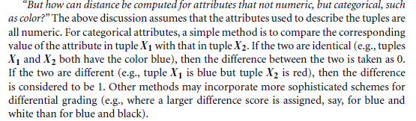
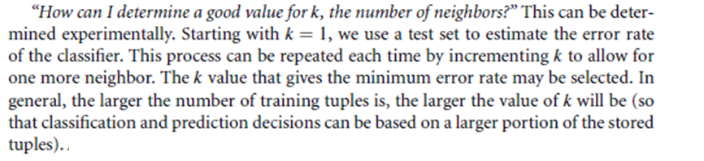
Issues Regarding KNN
1
2

Slide 82
The Value of K issue
Choosing the value of k:
If k is too small, sensitive to noise points
If k is too large, neighborhood may include points from other classes
It is preferred to choose an odd value for K. (Why?)

Slide 83
In Class Exercise
Q) Given the following Test Dataset, use the 3 NN to:
1) Build The Confusion Matrix.
2) Find the classification Accuracy for the Model.
This is the actual class label
No | Age | Income | Student | Credit Rating | Buys computer
1 | Youth | High | No | Fair | No
2 | Senior | Low | Yes | Excellent | Yes
3 | Middle-Age | High | No | Fair | Yes
4 | Youth | Medium | No | Excellent | No
5 | Senior | Low | Yes | Fair | Yes
Classifier Output
Estimated Accuracy = ??
= ?? %

Slide 84
Home Work
Q) Given the following Test Dataset, use the 3- NN Classifier to:
1) Build The Confusion Matrix.
2) Find the classification Accuracy for the Model.

Slide 85
In Class Practical Session for Data Classification Using K-NN

Slide 86
6.12 Accuracy and Error Measures

Slide 87
6.12 Accuracy and Error Measures
The accuracy of a classifier on a given test set is the percentage of test set tuples that are correctly classified by the classifier.
In the pattern recognition literature, this is also referred to as the overall recognition rate of the classifier, that is, it reflects how well the classifier recognizes tuples of the various classes.
We can also speak of the error rate or misclassification rate of a classifier, M, which is simply 1-Acc(M), where Acc(M) is the accuracy of M.
If we were to use the training set to estimate the error rate of a model, this quantity is known as the resubstitution error.
This error estimate is optimistic of the true error rate (and similarly, the corresponding accuracy estimate is optimistic) because the model is not tested on any samples that it has not already seen.

Slide 88
Confusion matrix
The confusion matrix is a useful tool for analyzing how well your classifier can recognize tuples of different classes. A confusion matrix contains information about actual and predicted classifications done by a classification system.
Given m classes, a confusion matrix is a table of at least size m by m. An entry, CM_{i,j} in the first m rows and m columns indicates the number of tuples of class i that were labeled by the classifier as class j.
For a classifier to have good accuracy, ideally most of the tuples would be represented along the diagonal of the confusion matrix, from entry CM_{1,1} to entry CM_{mj,m} with the rest of the entries being close to zero.
Accuracy of a classifier M, acc(M): percentage of test set tuples that are correctly classified by the model M
Error rate (misclassification rate) of M = 1 – acc(M)
Alternative accuracy measures (e.g., for cancer diagnosis)

Slide 89
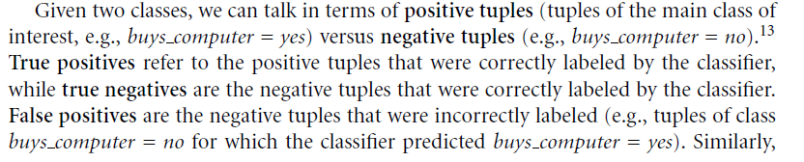

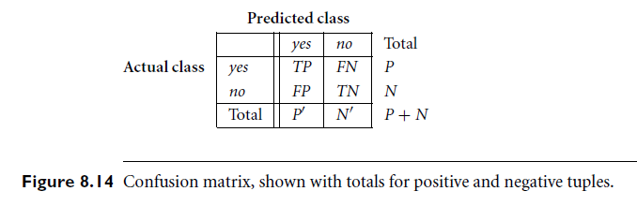
Confusion matrix

Slide 90
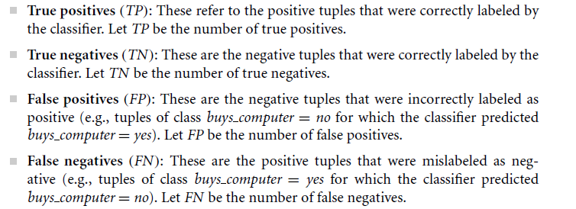

Confusion matrix

Slide 91
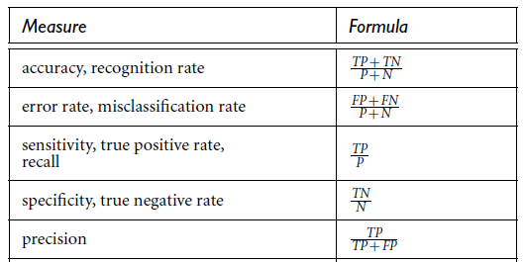
Confusion matrix

Slide 92

Example: How to Interpret the values in the Matrix
classes | buy_computer = yes | buy_computer = no | total | Recognition (%)
buy_computer = yes | 6954 | 46 | 7000 | = 99.34
buy_computer = no | 412 | 2588 | 3000 | = 86.27
total | 7366 | 2634 | 10000 | = 95.52
Recognition (%) | ??? | ???
In Class Discussion.

Slide 93
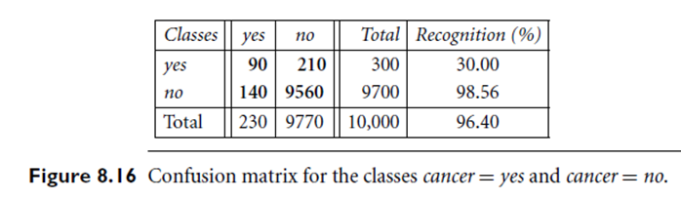
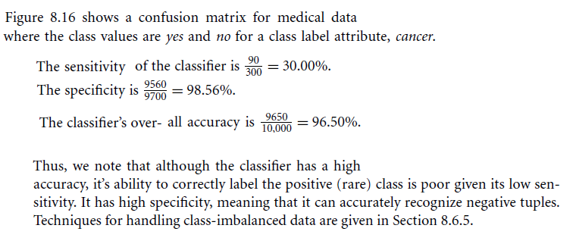
Example 2: Sensitivity and specificity

Slide 94

Example 3: Classifying iris flowers
Sepal length
Sepal width
Petal length
Petal width
Type
1
5.1
3.5
1.4
0.2
Iris setosa
2
4.9
3.0
1.4
0.2
Iris setosa
…
51
7.0
3.2
4.7
1.4
Iris versicolor
52
6.4
3.2
4.5
1.5
Iris versicolor
…
101
6.3
3.3
6.0
2.5
Iris virginica
102
5.8
2.7
5.1
1.9
Iris virginica
…
If petal length < 2.45 then Iris setosa
If sepal width < 2.10 then Iris versicolor
...

Slide 95
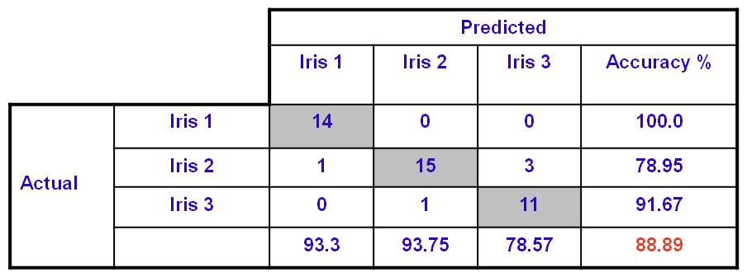
Example 2: How to Interpret the values in the Matrix
The Confusion Matrix result from a classification session for the Iris Dataset using WEKA tool.
- Data Set : 150 Objects
- Training Dataset : 105 objects (70%)
Testing Dataset : 45 objects (30%)
Classes : 3 ( Iris 1 (setosa) , Iris 2 (versoclolor), Iris 3 (verginica))
Table : Confusion Matrix for Iris Dataset
Accuracy of Classification using the test data set

Slide 96
Limitation of Accuracy
Consider a 2-class problem
Number of Class 0 examples = 9990
Number of Class 1 examples = 10
If model predicts everything to be class 0, accuracy is 9990/10000 = 99.9 %
Accuracy is misleading because model does not detect any class 1 example

Slide 97
Evaluating the Accuracy of a Classifier or Predictor
How can we use the above measures to obtain a reliable estimate of classifier accuracy (or predictor accuracy in terms of error)?
Holdout, random sub sampling, cross validation, and the bootstrap are common techniques for assessing accuracy based on randomly sampled partitions of the given data.
The use of such techniques to estimate accuracy increases the overall computation time, yet is useful for model selection.

Slide 98
Methods to find the accuracy using the Dataset
Use Training Dataset
Use an Independent Test Dataset
Random Holdout (Percentage split)
Random subsampling
Stratified Random Holdout
K-Fold Cross Validation
Leave one Out
Stratified K-Fold Cross Validation
BootStrap (Random with Replacement)

Slide 99
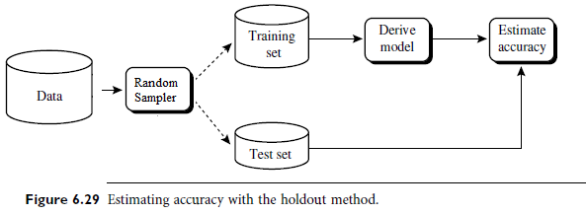
Holdout Method and Random Subsampling
Holdout / Percentage split:
In this method, the given data are randomly partitioned into two independent sets, a training set and a test set.
Typically, two-thirds (2/3) of the data are allocated to the training set, and the remaining one-third (1/3) is allocated to the test set.
The training set is used to derive the model, whose accuracy is estimated with the test set.
- Random sub sampling is a variation of the holdout method in which the holdout method is repeated k times. The overall accuracy estimate is taken as the average of the accuracies obtained from each iteration.

Slide 100
Example
Name | Rank | Year | Dean
Mohd | Assistant Prof | 3 | No
Qasem | Assistant Prof | 7 | Yes
Hasan | Professor | 2 | Yes
Azmi | Associate Prof | 7 | Yes
Hamedah | Assistant Prof | 6 | No
Fatimah | Associate Prof | 3 | No
Name | Rank | Year | Dean
Ali | Assistant Prof | 2 | No
Mohd | Assistant Prof | 3 | No
Qasem | Assistant Prof | 7 | Yes
Azeem | Associate Prof | 7 | No
Hasan | Professor | 2 | Yes
Azmi | Associate Prof | 7 | Yes
Hamedah | Assistant Prof | 6 | No
Lim | Professor | 5 | Yes
Ahmad | Assistant Prof | 7 | Yes
Fatimah | Associate Prof | 3 | No
Train Dataset
Name | Rank | Year | Dean
Ali | Assistant Prof | 2 | No
Azeem | Associate Prof | 7 | No
Lim | Professor | 5 | Yes
Ahmad | Assistant Prof | 7 | Yes
Test Dataset
An Illustrative Example

Slide 101
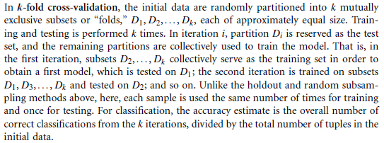
Cross-validation
Cross-validation (k-fold, where k = 10 is most popular)
Leave-one-out is a special case of k-fold cross-validation where k is set to the number of initial tuples. That is, only one sample is “left out” at a time for the test set.
Stratified cross-validation: folds are stratified so that class dist. in each fold is approx. the same as that in the initial data.
In general, stratified 10-fold cross-validation is recommended for estimating accuracy

Slide 102
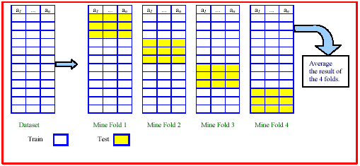
Illustration of K-Fold Cross Validation
Example of a 4-Fold Cross Validation
An Illustrative Example

Slide 103
Evaluating the Accuracy of a Classifier or Predictor (II)
Bootstrap
Works well with small data sets
Samples the given training tuples uniformly with replacement
i.e., each time a tuple is selected, it is equally likely to be selected again and re-added to the training set
Several boostrap methods, and a common one is .632 boostrap
Suppose we are given a data set of d tuples. The data set is sampled d times, with replacement, resulting in a training set of d samples. The data tuples that did not make it into the training set end up forming the test set. About 63.2% of the original data will end up in the bootstrap, and the remaining 36.8% will form the test set (since (1 – 1/d)^{d} ≈ e⁻¹ = 0.368)
Repeat the sampling procedue k times, overall accuracy of the model:
Note: To be presented by one of the good students with full example.

Slide 104
In Class Practical Session Accuracy and Error Measures

Slide 105
Rule base Classification

Slide 106
6.5.1 Using IF-THEN Rules for Classification
A rule-based classifier uses a set of IF-THEN rules for classification. An IF-THEN rule is an expression of the form IF condition THEN conclusion.
Example:
R1: IF age = youth AND student = yes THEN buys_computer = yes
Or
Rule antecedent/condition (LHS) vs. rule consequent (RHS)
If the condition (that is, all of the attribute tests) in a rule antecedent holds true for a given tuple, we say that the rule antecedent is satisfied (or simply, that the rule is satisfied) and that the rule covers the tuple.

Slide 107
Example of Rules
Example: Rule extraction from our buys_computer decision-tree

Slide 108
Building Classification Rules
Direct Method:
Extract rules directly from data
e.g.: RIPPER, CN2, Holte’s 1R
Indirect Method:
Extract rules from other classification models (e.g. decision trees, neural networks, etc).
e.g: C4.5rules

Slide 109
Rule Extraction from a Decision Tree
Rules are easier to understand than large trees
One rule is created for each path from the
root to a leaf.
Each attribute-value pair along a path forms a conjunction: the leaf holds the class prediction
Rules are mutually exclusive and exhaustive
Example: Rule extraction from our buys_computer decision-tree

Slide 110


Using IF-THEN Rules for Classification
A rule R can be assessed by its coverage and accuracy
n_{covers} = # of tuples covered by R
n_{correct} = # of tuples correctly classified by R
Coverage(R) = n_{covers} /|D| /* D: training data set */
Accuracy(R) = n_{correct} / n_{covers}
That is, a rule’s coverage is the percentage of tuples that are covered by the rule (i.e., whose attribute values hold true for the rule’s antecedent).
For a rule’s accuracy, we look at the tuples that it covers and see what percentage of them the rule can correctly classify.

Slide 111
Example
Given the dataset of AllElectronics (D) and the following rule (R1):
R1 : IF (age=youth and student =yes ) THEN Buy_computer=yes
Coverage(R1)=2/14=14.28%
Accuracy(R1)=2/2=100%
Condition
Rule Consequence

Slide 112
Using the Rule base Classifier
Use Rule_based classification to predict the class label of a given tuple X .
Example :
X = (age=youth ,income =medium , student =yeas , credit_rating=fair)
If Rule satisfied X then the Rule called Triggered then return the class label
If we have more than one Rule and these Rules triggered and all the class labels of these Rules are same (no problem) then return the class label
If we have more than one Rule and these Rules triggered (satisfied the tuple) and the rules have different class labels ……Then What to do (Problem 1)
What if no Rule satisfies the tuple X (Problem 2).

Slide 113
Using the Rule base Classifier
To solve these problems :
For the problem 1 we can use
Size ordering.
Rule ordering.
Class Ordering.
(Note: See Next Slide)
For the problem 2 we can use
The Fallback or the default Rule strategy:
Example of the default rule Rx :
IF ( ) THEN Buy_computer =“Yes”
Here we choose the class label use majority voting (the most frequency of the class label)

Slide 114
Using IF-THEN Rules for Classification
If more than one rule is triggered, we need a conflict resolution strategy:
Size ordering: assign the highest priority to the triggering rules that has the “toughest” requirement (i.e., with the most attribute test)
Class-based ordering: decreasing order of prevalence or misclassification cost per class
Rule-based ordering (decision list): rules are organized into one long priority list, according to some measure of rule quality or by experts

Slide 115
Advantages of Rule-Based Classifiers
As highly expressive as decision trees
Easy to interpret
Easy to generate
Can classify new instances rapidly
Performance comparable to decision trees

Slide 116
Rule Extraction from the Training Data
Sequential covering algorithm: Extracts rules directly from training data
Typical sequential covering algorithms: FOIL, AQ, CN2, RIPPER
Rules are learned sequentially, each for a given class C_{i} will cover many tuples of C_{i} but none (or few) of the tuples of other classes
Steps:
Rules are learned one at a time
Each time a rule is learned, the tuples covered by the rules are removed
The process repeats on the remaining tuples unless termination condition, e.g., when no more training examples or when the quality of a rule returned is below a user-specified threshold
Comp. w. decision-tree induction: learning a set of rules simultaneously
Note: To be presented by one of the good students with Complete example.

Slide 117
Classification using ZeroR and OneR methods

Slide 118
ZeroR
ZeroR is considered the simplest data mining method. is about finding a class with the maximum frequency
Inputs
Target
Outlook | Temp. | Humidity | Windy | Play
Sunny | Hot | High | False | No
Sunny | Hot | High | True | No
Overcast | Hot | High | False | Yes
Rainy | Mild | High | False | Yes
Rainy | Cool | Normal | False | Yes
Rainy | Cool | Normal | True | No
Overcast | Cool | Normal | True | Yes
Sunny | Mild | High | False | No
Sunny | Cool | Normal | False | Yes
Rainy | Mild | Normal | False | Yes
Sunny | Mild | Normal | True | Yes
Overcast | Mild | High | True | Yes
Overcast | Hot | Normal | False | Yes
Rainy | Mild | High | True | No

Slide 119
ZeroR
Play
No
No
Yes
Yes
Yes
No
Yes
No
Yes
Yes
Yes
Yes
Yes
No
Play
No
No
No
No
No
Yes
Yes
Yes
Yes
Yes
Yes
Yes
Yes
Yes
5 / 14 = 0.36
Sort
Yes
9 / 14 = 0.64

Slide 120
Exercise / Home Work (1)
Q) Given the following Test Dataset and the previous ZeroR method,
1) Build The Confusion Matrix.
2) Find the classification Accuracy for the Model.
Outlook | Temp | Humidity | Windy | Play
Sunny | Hot | High | False | Yes
Sunny | Hot | High | True | No
Overcast | Hot | High | False | Yes
Rainy | Mild | High | False | Yes
Rainy | Cool | Normal | True | No
Overcast | Mild | High | True | No
Sunny | Mild | Normal | True | Yes
Overcast | Hot | Normal | False | Yes
Rainy | Mild | High | True | Yes

Slide 121
OneR
The original method of the One Rule method is presented in the paper
“Very Simple Classification Rules Perform Well on Most Commonly Used Datasets”
By: Robert C. Holte, Computer Science Department, University of Ottawa
OneR: is a simple but powerful method which performs not much worse than other complex methods

Slide 122
The OneR Motivation
Simple algorithm often work surprisingly well ( use the Simplicity first principle)
One attribute might do all the work ……
1R’s simple rules performed not much worse than much more complex decision trees
OneR: learns a 1-level decision tree
In other words, generates a set of rules that all test on one particular attribute.
Basic version (assuming nominal attributes)
One branch for each of the attribute’s values
Each branch assigns most frequent class
Error rate: proportion of instances that don’t belong to the majority class of their corresponding branch
Choose attribute with lowest error rate

Slide 123
Pseudo-code for OneR
For each attribute,
For each value of the attribute
count how often each class appears for each value
find the most frequent class
make the rule (assign that class to this attribute-value)
Calculate the error rate of the rules
Choose the rules with the smallest error rate

Slide 124
OneR: Example
Outlook | No Yes
--------------------------------------
Sunny | 3 2
--------------------------------------
Overcast | 0 4
--------------------------------------
Rainy | 2 3
Step 1: Count the Number of values for each attribute for each class.
Outlook | Temp | Humidity | Windy | Play
Sunny | Hot | High | False | No
Sunny | Hot | High | True | No
Overcast | Hot | High | False | Yes
Rainy | Mild | High | False | Yes
Rainy | Cool | Normal | False | Yes
Rainy | Cool | Normal | True | No
Overcast | Cool | Normal | True | Yes
Sunny | Mild | High | False | No
Sunny | Cool | Normal | False | Yes
Rainy | Mild | Normal | False | Yes
Sunny | Mild | Normal | True | Yes
Overcast | Mild | High | True | Yes
Overcast | Hot | Normal | False | Yes
Rainy | Mild | High | True | No
Temp | No Yes
--------------------------------------
Hot | 2 2
--------------------------------------
Mild | 2 4
--------------------------------------
Cool | 1 3
Humidity | No Yes
--------------------------------------
High | 4 3
--------------------------------------
Normal | 1 6
Windy | No Yes
--------------------------------------
False | 2 6
--------------------------------------
True | 3 3

Slide 125
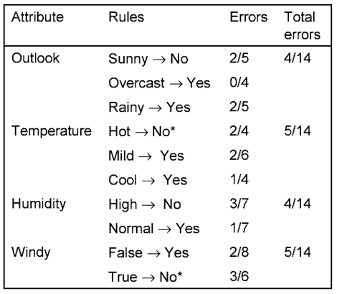
Find Total Error Rate for Each Attribute
Step 3: Generate the One Rule from the Outlook attribute.
Outlook | No Yes
---------------------------------
Sunny | 3 2
---------------------------------
Overcast | 0 4
---------------------------------
Rainy | 2 3
If (Outlook = Overcast) then Play (Yes)
Else
If (Outlook = Sunny) then Don’t Play (No)
Else
If (Outlook = Rainy) then Play (Yes)
Step 2: Select (Outlook) as the best attribute to generate the One Rule. Error rate= 4/14 (28.5%)

Slide 126
Exercise / Home Work (2)
Q) Given the following Test Dataset and the previous OneR,
1) Build The Confusion Matrix.
2) Find the classification Accuracy for the Model.
Outlook | Temp | Humidity | Windy | Play
Sunny | Hot | High | False | Yes
Sunny | Hot | High | True | No
Overcast | Hot | High | False | Yes
Rainy | Mild | High | False | Yes
Rainy | Cool | Normal | True | No
Overcast | Mild | High | True | No
Sunny | Mild | Normal | True | Yes
Overcast | Hot | Normal | False | Yes
Rainy | Mild | High | True | Yes

Slide 127
An example of a discretization method used within the OneR classification approach

Slide 128
The Weather Dataset: Reminder
Outlook | Temp | Humidity | Windy | Play
Sunny | 85 | High | False | No
Sunny | 80 | High | True | No
Overcast | 83 | High | False | Yes
Rainy | 70 | High | False | Yes
Rainy | 68 | Normal | False | Yes
Rainy | 65 | Normal | True | No
Overcast | 64 | Normal | True | Yes
Sunny | 72 | High | False | No
Sunny | 69 | Normal | False | Yes
Rainy | 75 | Normal | False | Yes
Sunny | 75 | Normal | True | Yes
Overcast | 72 | High | True | Yes
Overcast | 81 | Normal | False | Yes
Rainy | 71 | High | True | No
Given that the Temp attribute is Numeric. The question is how to discretize this attribute.

Slide 129
Numeric attributes discretization
Step 1: The training examples are sorted according to the values of the numeric attributes
64 65 68 69 70 71 72 72 75 75 80 81 83 85 Temp
yes no yes yes yes no no yes yes yes no yes yes no Play
Step 2: Partitioning the sequence by placing breakpoints wherever the class changes
64 65 68 69 70 71 72 72 75 75 80 81 83 85 Temp
yes no yes yes yes no no yes yes yes no yes yes no Play

Slide 130
Numeric attributes discretization (cont.)
Step 3: A minimum number of examples (e.g., 3) of the majority class in each position
64 65 68 69 70 71 72 72 75 75 80 81 83 85 Temp
yes no yes yes yes no no yes yes yes no yes yes no Play
Step 4: Merge adjacent partitions which have the same majority class
64 65 68 69 70 71 72 72 75 75 80 81 83 85 Temp
yes no yes yes yes no no yes yes yes no yes yes no Play
Step 5: The rule for the discretized temperature:
This is the One Rule Generated for
the Temp attribute.

Slide 131
In Class WEKA Session: Classification using ZeroR and OneR Methods

Slide 132
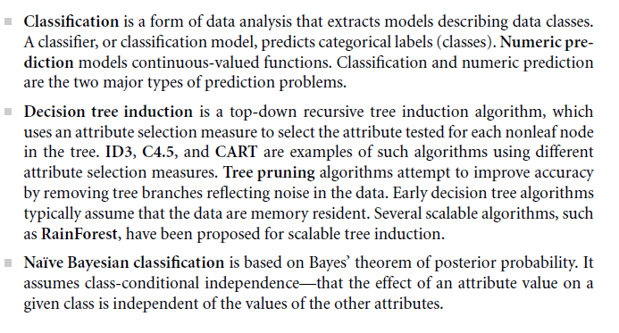
Summary

Slide 133
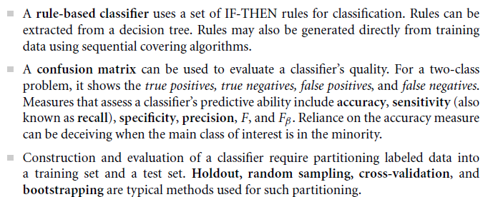
Summary

